Slide 1

Department of Computer Science and Engineering
First Review Presentation of the Project Phase 1 +Seminar(17CSP78)
INTUITIVE PERCEPTION: SPEECH RECOGNITION USING MACHINE LEARNING
Batch No: 2020_CSE_14
Under the guidance of : Dr. Swathi K Assistant professor Dept of CSE , KSIT
Roopashree N | 1KS17CS064
Sai Sneha S V | 1KS17CS070
Spoorthi V | 1KS17CS082

Slide 2
Contents
Introduction
Literature Survey
Problem Identification, Statement and Scope
Goals and Objectives
Methodology
Expected Outcomes
Contribution to Society
References

Slide 3

What is Lip reading/Speech Recognition?
Lipreading, also known as visual speech recognition is the task of understanding speech by analyzing the movement of lips. Alternatively, it could be described as the process of decoding text from visual information generated by the speaker’s mouth movement.

Slide 4
Machine Learning is widely used for lip reading and for improving speech recognition.
Visual lip-reading plays an important role in human-computer interaction in noisy environments
Possible applications: help people with hearing disabilities, surveillance systems, etc.
Typical lip-reading systems face several challenges due to variances in the inputs.
several different words can be spoken with almost indistinguishable lip movements.
The use of Deep Learning and deep neural networks has revolutionized the quality of automated lip-reading systems, resulting in more accurate models.
INTRODUCTION

Slide 5
LITERATURE SURVEY
PAPER TITLE | AUTHOR NAMES | DATE & YEAR
Automatic Lip-Reading System Based on Deep Convolutional Neural Network and Attention-Based Long Short-Term Memory | Yuanyao Lu * and Hongbo L | 17 April 2019
Largescale visual speech recognition | Brendan Shillingford & Team | 13 Jul 2018
Lip Movements Generation at a Glance | Lele Chen, Zhiheng Li, Ross K. Maddox, Zhiyao Duan and Chenliang Xu | 28 Mar 2018
Improving Speaker Independent Lipreading with Domain Adversarial Training | Michael Wand and Jurgen Schmidhuber | 4 Aug 2017
Lip Reading Sentences in the Wild | Joon Son Chung, Andrew Senior, Oriol Vinyals and Andrew Zisserman | 16 Nov 2018

Slide 6
Existing Speech Recognition Systems use ASR
For Surveillance Systems that do not include audio , speech recognition is difficult
Problem Identification

Slide 7
PROBLEM STATEMENT
This project mainly aims at preprocessing a video sample which would then be systematically cropped, and the required features would be extracted and then fed to an artificially intelligent system to map variable-length sequences of video frames to text sequences, and it is trained end to end.

Slide 8
SCOPE
addressing security issues.
aims at overcoming the shortcoming of the existing surveillance systems.
The main highlight of this project is to overcome the human inaccuracy and to achieve error prevention.

Slide 9
GOALS AND OBJECTIVES
To predict the words spoken by the speaker accurately.
To recognize the sentences not only for a single video but for the whole dataset
To place the tracker around the lip region accurately.
To normalize the video samples so that uniformity is maintained.
To decode the text spoken by the speaker correctly.

Slide 10
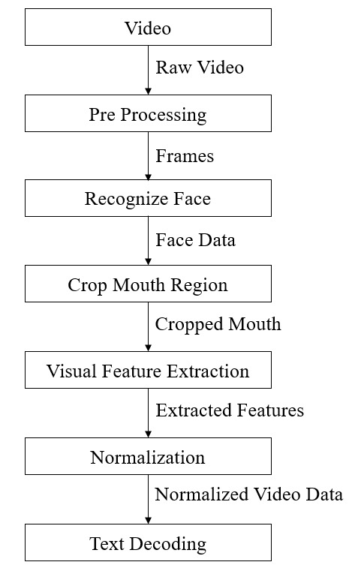
METHODOLOGY
Module 1 - Pre-Processing
Input: Video in RGB color format.
Output: Set of frames in greyscale
Module 2 - Face detection and cropping
Input: Still frames of grayscale images.
Output: Faces with ROI cropped
Module 3- Feature extraction and normalization
Input: ROI images
Output: Normalized frames ready with features extracted.
Module 4 - Text classification and decoding
Input: Image data containing normalized frames.
Output: Predicted text played in parallel to the video.

Slide 11
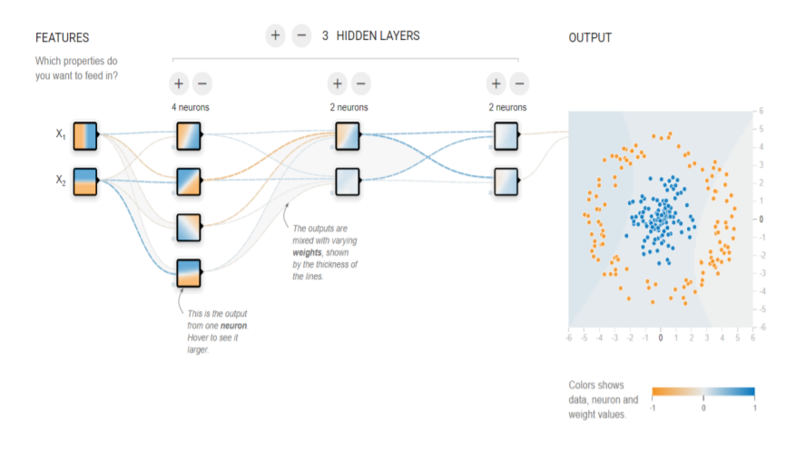
SYSTEM ARCHITECTURE
The architecture of the proposed system is based on working of a CNN.
The system makes use of an input layer, three hidden layers and an output layer.
The features extracted from each initial layer is fed into the next layer.

Slide 12
Dataset
GRID CORPUS dataset from the University of Sheffield.
the corpus consists of high-quality audio and video (facial) recordings of 1000 sentences spoken by each of 34 talkers (18 male, 16 female).
The utterance of each word can be represented in the form of verb (4) + color (4) + preposition (4) + alphabet (25) + digit (10) + adverb (4).
Sentences are of the form "put red at G9 now“.
The videos are recorded in a controlled lab environment.
Grid Corpus Dataset

Slide 13
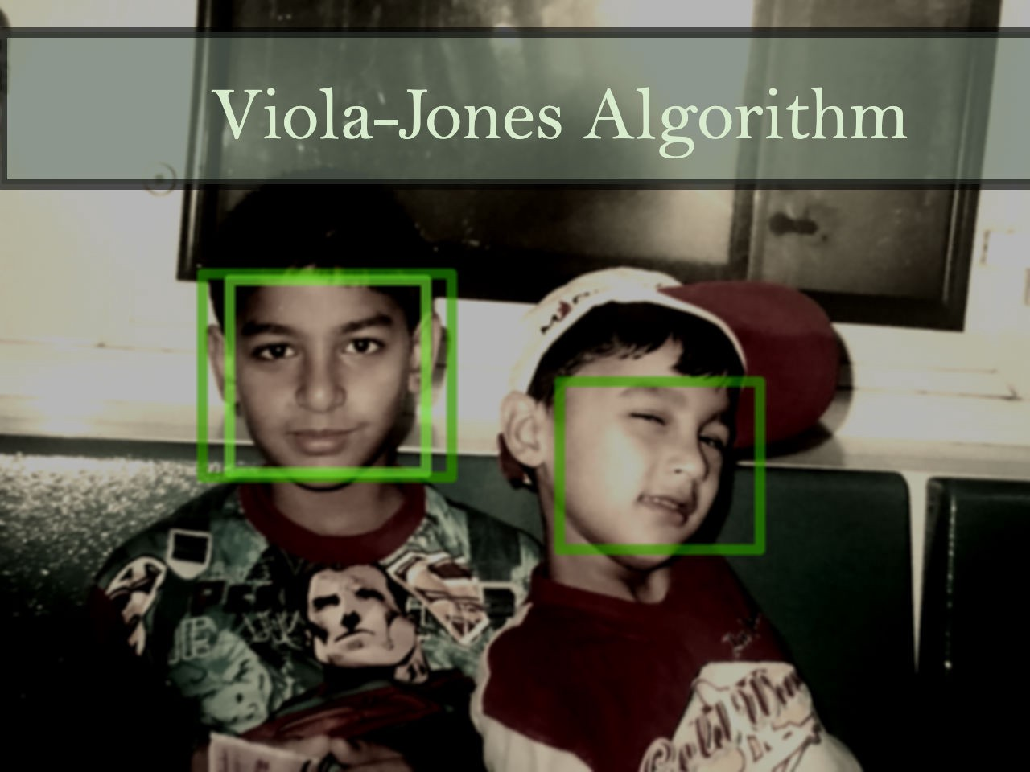
Face Detection using Viola Jones Algorithm
The Viola-Jones algorithm was developed in 2001 by Paul Viola and Michael Jones.
Viola-Jones was designed for frontal faces, so it is able to detect frontal the best rather than faces looking sideways, upwards or downwards. Before detecting a face, the image is converted into grayscale, since it is easier to work with and there’s lesser data to process.
The Viola Jones algorithm has four main steps:
1.Selecting Haar-like features
2.Creating an integral image
3. Running AdaBoost training
4.Creating classifier cascades

Slide 14
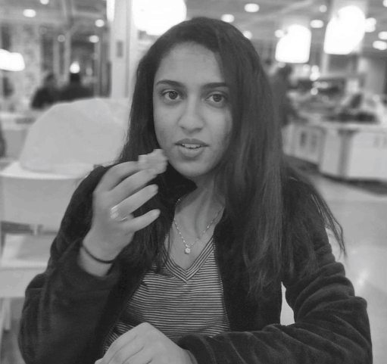
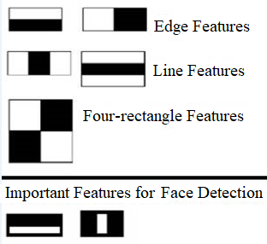
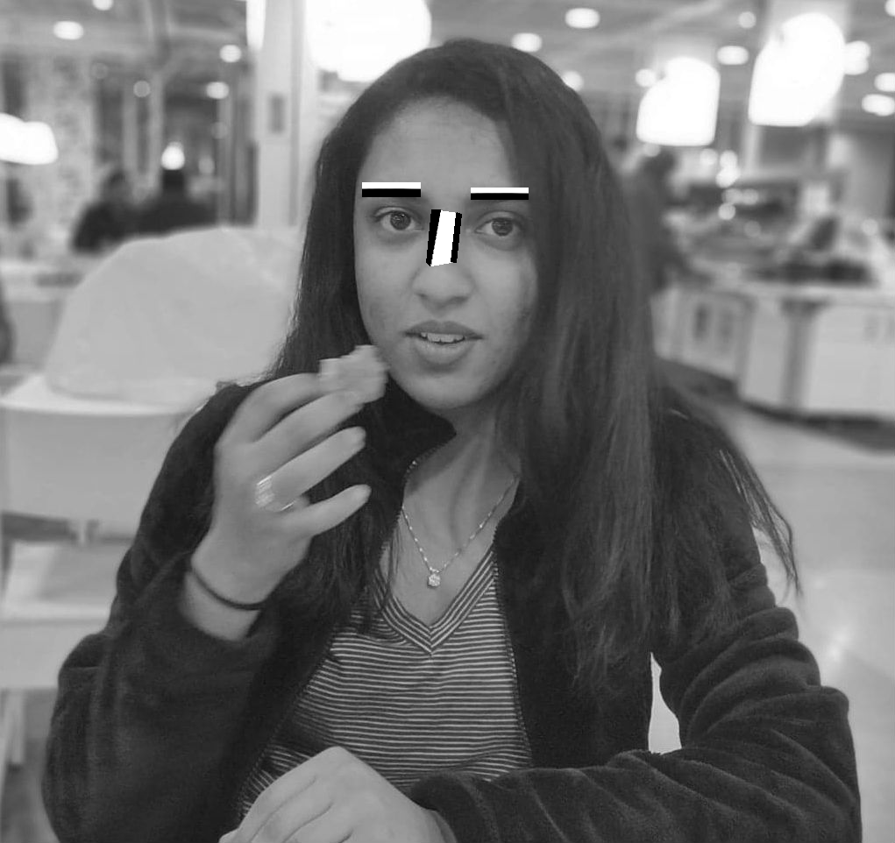
1. SELECTING HAAR-LIKE FEATURES
The Viola-Jones algorithm first detects the face on the grayscale image and then finds the location on the coloured image.
This algorithm outlines a box and searches for a face within the box. It is essentially searching for these Haar-like features.
These Haar-like features show a box with a light side and a dark side, which is how the machine determines what the feature is.
There are 3 types of Haar-like features:
Edge features
Line-features
Four-sided features
Sometimes one side will be lighter than the other, as in an edge of an eyebrow. Sometimes the middle portion may be shinier than the surrounding boxes, which can be interpreted as a nose. Examples of these are shown in the ppt

Slide 15
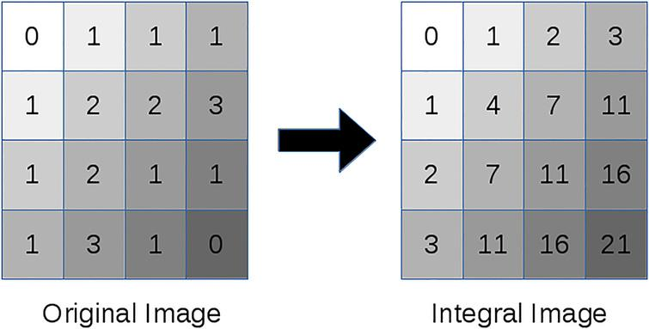
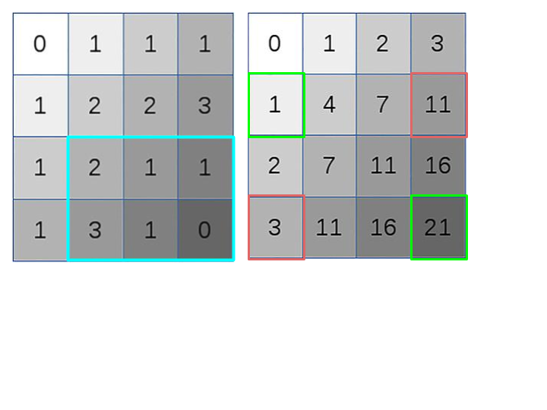
2. CREATING AN INTEGRAL IMAGE
Now imagine the one highlighted in blue is our grid for a certain feature, and we are trying to calculate the value of that feature. Normally we would just add up the boxes, but since that can be computationally intensive, we will create an integral image.
In an integral image, the value of each point is the sum of all pixels above and to the left, including the target pixel.
The green box in the integral image is calculated as the sum of the highlighted area in the regular image. If we did this for every box, we would have a sequence going through the grid and it may look something like the image in the left

Slide 16
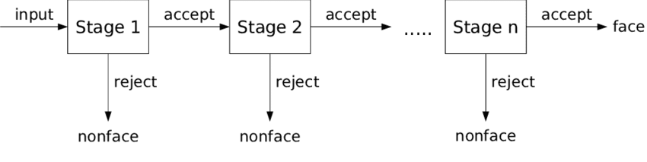
3. RUNNING ADABOOST TRAINING
The Adaptive Boost training helps the algorithm learn from the images we supply it and is able to determine the false positives and true negatives in the data, allowing it to be more accurate. We would get a highly accurate model once we have looked at all possible positions and combinations of those features.
4. CREATING CLASSIFIER CASCADES
Basically, If the first stage gives a negative evaluation, then the image is immediately discarded as not containing a human face. If it passes the first stage but fails the second stage, it is discarded as well. Basically, the image can get discarded at any stage of the classifier.

Slide 17

EXPECTED OUTCOMES
We propose Intuitive Perception, a trained model to translate the video sample to a subtitled video.
A new, faster and an efficient way for the recognition of lip movement appearance and predicting the words or phrases spoken in English language based on the video data fed as an input.
This system may be employed in various fields like forensics, film processing, aid to the deaf and dumb, security, etc.

Slide 18
Contribution to Society
Useful at Crime scenes
Helpful for people with hearing disabilities
To generate subtitles

Slide 19
REFERENCES
https://www.researchgate.net/publication/332491807_Automatic_Lip-Reading_System_Based_on_Deep_Convolutional_Neural_Network_and_Attention-Based_Long_Short-Term_Memory
https://papers.nips.cc/paper/858-lipreading-by-neural-networks-visual-preprocessing-learning-and-sensory-integration
https://medium.com/@RaghavPrabhu/understanding-of-convolutional-neural-network-cnn-deep-learning-99760835f148
https://towardsdatascience.com/the-intuition-behind-facial-detection-the-viola-jones-algorithm-29d9106b6999
https://www.researchgate.net/publication/326412569_Large-Scale_Visual_Speech_Recognition
Brendan Shillingford, Yannis Assael, Matthew W. Hoffman, Thomas Paine, Cían Hughes, Utsav Prabhu, Hank Liao, Hasim Sak, Kanishka Rao, Lorrayne Bennett, Marie Mulville, Ben Coppin, Ben Laurie, Andrew Senior and Nando de Freitas, LARGE SCALE VISUAL SPEECH RECOGNITION. DeepMind & Google.[13th July 2018]
Lele Chen, Zhiheng Li, Ross K. Maddox, Zhiyao Duan and Chenliang Xu, Lip Movements Generation at a Glance. Wuhan university and University of Rochester. .[28th March 2018]
Michael Wand and Jurgen Schmidhuber, Improving Speaker Independent Lipreading with Domain Adversarial Training. The Swiss AI Lab IDSIA, USI & SUPSI, MannoLugano, Switzerland, arXiv:1708.01565v1 [cs.CV] [4th Aug 2017.]
Joon Son Chung, Andrew Senior, Oriol Vinyals and Andrew Zisserman, Lip Reading Sentences in the Wild. Department of Engineering Science, University of Oxford 2Google DeepMind [16th November 2016]
Viola, P.; Jones, M. Rapid object detection using a boosted cascade of simple features. In Proceedings of the 2001 IEEE Computer Society Conference on Computer Vision and Pattern Recognition. CVPR 2001, volume 1, 2001, ISSN 1063-6919, pp. I–511–I–518 vol.1, doi:10.1109/CVPR.2001.990517.

